Slide 1
Elizabeth Bishop
In the waiting room
Eman Ahmad Al-Ghamdi
Sal7a Hussain AL-Montasheri
Areej Ahmad khalf
Doa’a Nashag8i
Ameera AL.Ghamdi
Ilham AL.Ghamdi

Slide 2
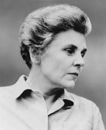
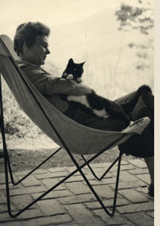
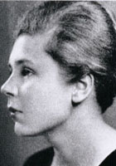
Elizabeth Bishop
1911-1979

Slide 3
Elizabeth Bishop was born in Worcester, Massachusetts to a Canadian mother and an American father. She was an American poet. She was the Poet Laureate of the United States from 1949 to 1950, and a Pulitzer Prize winner in 1956. Elizabeth Bishop House is an artist's retreat in Great Village, Nova Scotia dedicated to her memory. She is considered one of the most important and distinguished American poets of the 20th century.
She was influenced by the poet Marianne Moore, who was a close friend, mentor, and stabilizing force in her life. Bishop's poetry avoids explicit accounts of her personal life, and focuses instead with great subtlety on her impressions of the physical world.

Slide 4
Her images are precise and true to life, and they reflect her own sharp wit and moral sense. She lived for many years in Brazil, communicating with friends and colleagues in America only by letter. She wrote slowly and published sparingly (her Collected Poems number barely a hundred), but the technical brilliance and formal variety of her work is astonishing. For years she was considered a "poet's poet," but with the publication of her last book, Geography III, in 1976, Bishop was finally established as a major force in contemporary literature.
Elizabeth Bishop was awarded the Fellowship of The Academy of American Poets in 1964 and served as a Chancellor from 1966 to 1979. She died in Cambridge, Massachussetts, in 1979, and her stature as a major poet continues to grow through the high regard of the poets and critics who have followed her.

Slide 5
Bishop often spent many years writing a single poem, working toward an effect of offhandedness and spontaneity. Committed to a "passion for accuracy," she re-created her worlds of Canada, America, Europe, and Brazil. Shunning self-pity, the poems thinly conceal her estrangements as a woman, a lesbian, an orphan, a geographically rootless traveler, a frequently hospitalized asthmatic, and a sufferer of depression and alcoholism. "I'm not interested in big-scale work as such," she once told Lowell. "Something needn't be large to be good.“
Her best-known poems have remained standard anthology pieces, and a spate of recent studies, a biography, a collection of her letters, and even a book of her paintings demonstrate her high and constantly growing stature with literary scholars and critics.

Slide 6
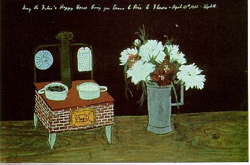
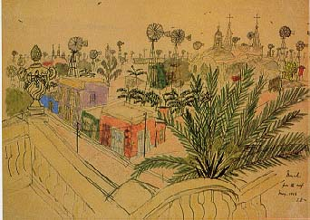
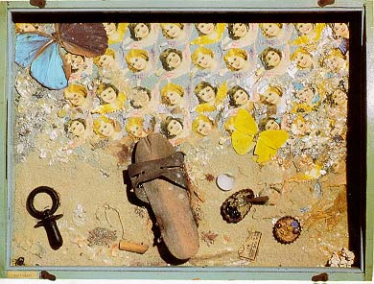
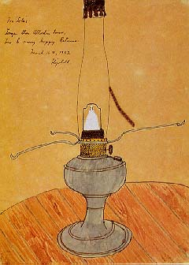
Some Of Elizabeth Bishop Painting :

Slide 7



Elizabeth Bishop poems:

Slide 8
Elizabeth Bishop poems:
Elizabeth Bishop's poems were always admired for the purity and precision of her descriptions, and now readers have come to see how, even in her early poems, the attention to external detail reveals an internal emotional realm. Bishop's early works use surrealism and imagism to create a new reality in which she minimizes the reference to self in poetry, but her later poems become more autobiographical and more concerned with a quest for personal identity.
Bishop’s use of imagery allowed her to address personal issues in her poems without the discomfort of self-exposure. An example of this is found in the poem "In the Waiting Room."

Slide 9

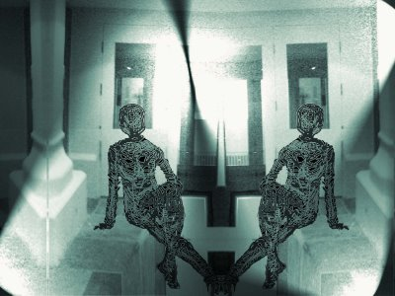

In the Waiting Room

Slide 10
In Worcester, Massachusetts,
I went with Aunt Consuelo
to keep her dentist's appointment
and sat and waited for her
in the dentist's waiting room.
It was winter. It got dark
early. The waiting room
was full of grown-up people,
arctics and overcoats,
lamps and magazines.
My aunt was inside
what seemed like a long time
and while I waited and read
the National Geographic
(I could read) and carefully
studied the photographs:
the inside of a volcano,
black, and full of ashes;
then it was spilling over
in rivulets of fire.
Osa and Martin Johnson
dressed in riding breeches,
laced boots, and pith helmets.
A dead man slung on a pole
"Long Pig," the caption said.
Babies with pointed heads
wound round and round with string;
black, naked women with necks
wound round and round with wire
like the necks of light bulbs.
Their breasts were horrifying.
I read it right straight through.
I was too shy to stop.
And then I looked at the cover:
the yellow margins, the date.
Suddenly, from inside,
came an oh! of pain
--Aunt Consuelo's voice--
not very loud or long.
I wasn't at all surprised;
even then I knew she was
foolish, timid woman.
I might have been embarrassed,
but wasn't. What took me
completely by surprise
was that it was me:
my voice, in my mouth.
Without thinking at all
I was my foolish aunt,
I--we--were falling, falling,
our eyes glued to the cover
of the National Geographic,

Slide 11
On the broadest level, "In the Waiting Room," like other Bishop poems, inscribes the terrifying instability of the "I" and individual identity as the traditional bounds between inside and outside,
The poem begins as the poetess, as a young girl sits in a dentist's office in Worcester, Massachusetts, waiting for her Aunt Consuelo, who is being treated. The young Elizabeth, in a waiting room as the title ,"In the Waiting room", suggests, reads quietly an issue of National Geographic magazine of 1918, She looks at the exotic photographs in National Geographic magazines.
The girl hears her aunt cry out in pain. Suddenly, she has a revelation about her identity. "In the Waiting Room" tend to agree that the poem presents a young girl's moment of awakening to the separations and the bonds among human beings, to the forces that shape individual identity through the interrelated recognitions of community and isolation." Elizabeth Bishop looks back in this poem on her anxious and overwhelmed child self with still-fresh empathy, but with the assurance and control of the accomplished artist.

Slide 12
“In the Waiting Room,” concerns young Bishop's sudden awareness of both the division and the connection between herself and the world. The child in this poem appears orphaned (no mother or father enters the picture, only her ("aunt"), and this makes her attempt to domesticate the strange particularly poignant--even more so when we remember that Elizabeth Bishop herself was brought up not by her parents but by an assortment of relations.
"In the Waiting Room", Bishop's endeavors to find her own definition of gender, rejecting society's indoctrinated beliefs and questioning their validity. She enables the reader to slip easily into this dense subject matter of her poem by employing several deceptively simple poetic techniques .
The lack of information intensifies the child's isolation, making her all the more vulnerable in the reader's mind." The intentional omission of these details urges the reader to attempt a greater understanding of the girl's situation. If Bishop spells everything out for the reader, it may not be as mysterious and provocative enough to interest and get a second reading

Slide 13
Conclusion :
Finally This long poem is one of Elizabeth Bishop's finest evocations of the magic in ordinary life. Through a child's consciousness, she illuminates the oceanic or mystical experience of connectedness.
Elizabeth see that Women are still waiting; waiting to advance to their rightful place in society, and waiting to be recognized as equals in a world that for too long has physically and mentally marked and restrained them. The themes of what society deems women to be, and how women themselves come to terms with that definition, are ones that will not be resolved in the near future, ensuring that "In the Waiting Room" will
remain powerful and provocative for a long time to come.

Slide 14

Listen To Bishop poem ,
In The Waiting Room ,,

Slide 15


Slide 16
Eman Ahmad Al-Ghamdi
Sal7a Hussain AL-Montasheri
Areej Ahmad khalf
Doa’a Nashag8i
Ameera AL.Ghamdi
Ilham AL.Ghamdi

